Slide 1
Chapter 3: Mountains & Volcanoes
Mountains

Slide 2
What is a mountain?
A mountain is an area of land that rises steeply from the land around it.
Most mountains belong to ranges, and ranges that are close together make up belts.
Most mountain belts are located along plate boundaries.

Slide 3
Mountains
Some processes wear mountains down:
Water/wind break rocks apart into sediments
Eventually most mountains become small hills.
If mountains are being eroded at the same rate that they are being built up, they stay the same height.

Slide 4
Types of Mountains - Folded
A folded mountain forms at a convergent boundary, where the rocks have great stress.
Some rocks begin to break, others fold.
As the continental crust crumples and bends, a mountain forms.
Example: Himalayan Mountains

Slide 5
Types of Mountains – Folded Formation
Step 1: Convergent boundary develops and subduction occurs.
Step 2: Continental Collision Begins and crust crumples/folds
Step 3: Collision continues, and the mountains gets larger.

Slide 6
Types of Mountains – Folded

Slide 7
Types of Mountains – Fault-block
A fault-block mountain forms as blocks of rock move up or down normal faults.
Stress repeatedly builds in the crust and is released in an earthquake.

Slide 8
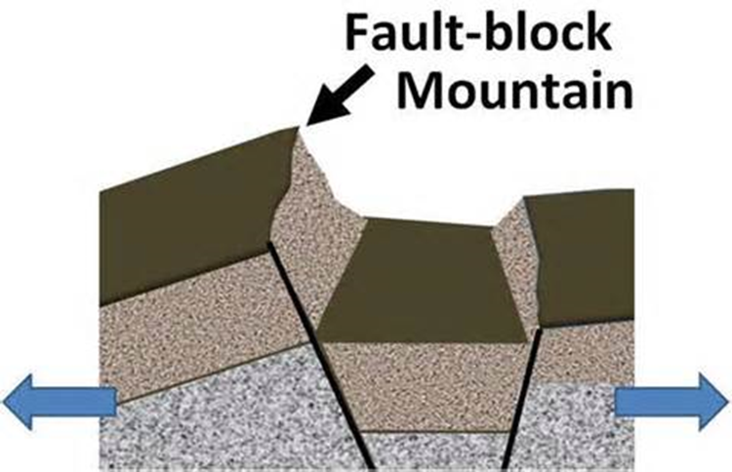
Types of Mountains – Fault-Block Formation
Step 1: The lithosphere is stretched and pulled apart, breaking the crust into blocks.
Step 2: some blocks tilt up = mountains
Step 3: some blocks tilt downward = valleys

Slide 9
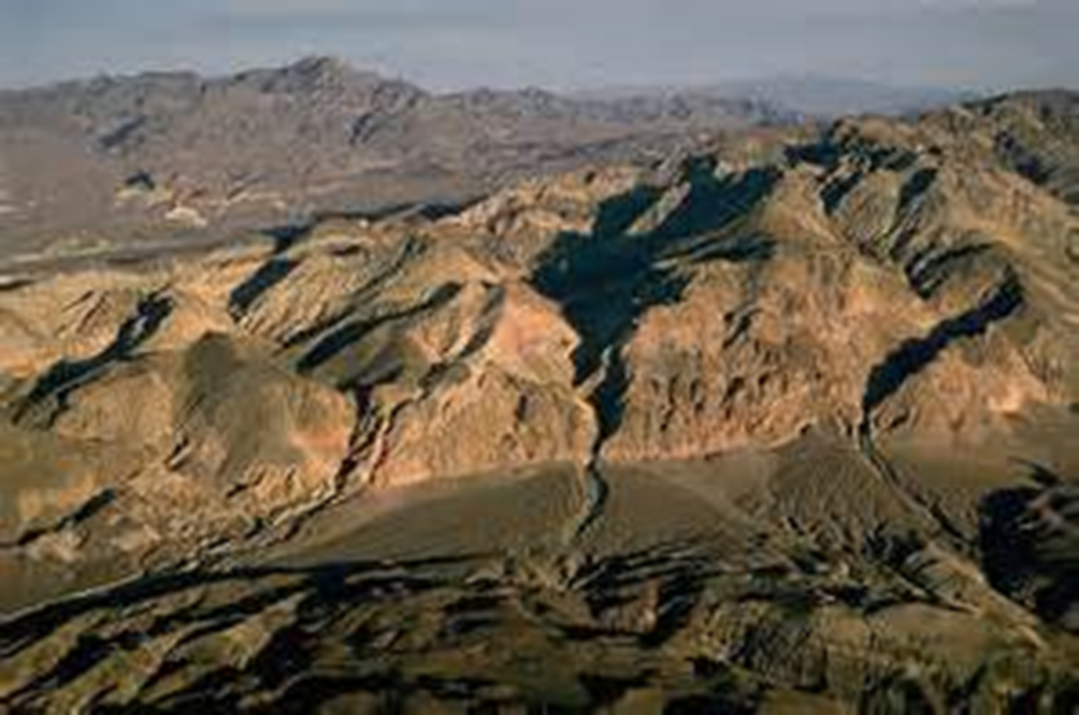
Types of Mountains – Fault-Block

Slide 10
Chapter 3: Mountains & Volcanoes
Volcanoes

Slide 11
What is a volcano?
A volcano is an opening in Earth’s crust through which molten rock, rock fragments, and hot gases erupt.
A volcano is also a mountain built from erupted material.

Slide 12
Volcano Formation
Usually at tectonic plate boundaries: subduction zones and divergent boundaries.
Sometimes at hot spots

Slide 13
Volcano Eruptions
A violent eruption can cause tremendous destruction even if not much molted rock reaches the surface.
A gentle eruption can pour out rivers of molten rock that flow long distances.

Slide 14
Magma
Made of silica (silicon and oxygen) and gases
Magma that‘s high in silica resists flow, and magma that’s low in silica flows easily.
The gases get trapped in the silica, and eventually blast out of a volcano.

Slide 15
Magma
Will rise inside a volcano as long as it is less dense than the surrounding rock.
It can collect in a magma chamber and form igneous rock, or it can erupt.
When it erupts and reaches the surface, it is called lava.

Slide 16
Rock Fragments
When gas bubbles pop, magma breaks apart.
Large pieces of lava are thrown into the air, cool down, and harden into rock.
Rocks from volcanic walls erupt.

Slide 17
Rock Fragments – 4 types
Volcanic ash: consists of particles ranging from the size of dust to rice
Volcanic cinders
Volcanic bombs: molted when erupted
Volcanic blocks: solid pieces of rock; can be as big as houses

Slide 18
Volcanic Gases
Main gases: water vapor and CO2
Sometimes they combine with water to form acids.
Sometimes they mix with rock pieces, forming a pyroclastic flow.
Most dangerous type of eruption.
Dense cloud of superhot gas/rocks

Slide 19
Chapter 3: Mountains & Volcanoes
Types of Volcanoes

Slide 20
Shield Volcano
Shaped like a broad, flat dome
Built up by eruptions of lava that are low in silica, spreading out in thin layers.

Slide 21
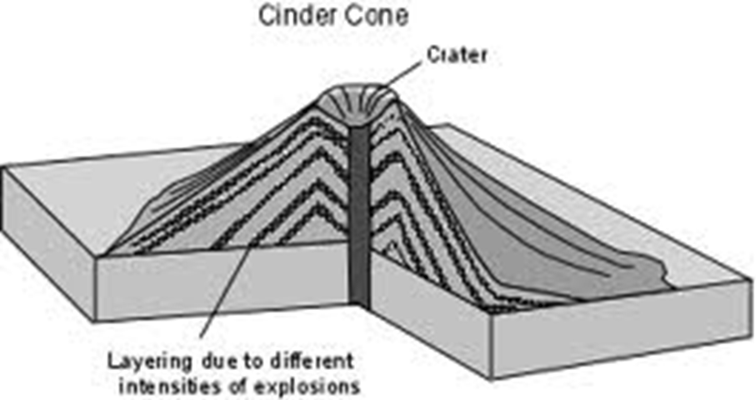
Cinder Cone Volcano
Steep, cone-shaped hill
Built up by eruptions of cinders and rock pieces that pile up around a crater

Slide 22
Composite Volcano
Cone-shaped; steep at top, flat at bottom
Built up of layers of lava and rock pieces
Magma is high in silica

Slide 23
Volcano Features – Caldera
Found on shield and composite
Huge crater formed by collapse of a volcano when magma erupts rapidly.
Calderas can hold lakes inside of them.

Slide 24
Predicting Eruptions
Earthquakes and changes in the tilt of the ground can indicate magma movement.
Scientists monitor the temp at openings in springs/lakes on volcanoes.
They monitor amounts/types of gases
They measure how much time has passed since last eruption.

Slide 25
Immediate Effects on Land
Lava flow: knocks down, covers, and burns objects in path
Volcanic Ash: weight of ash can collapse roofs; suffocate plants, animals, and people.
Mudflows: water forms with ash and particles; can bury entire towns

Slide 26
Immediate Effects on Land
Pyroclastic flow: knocks down/burns everything in way; tends to make valleys
Landslides: downhill movement of rock if volcano collapses; can cause tsunamis
Steam explosion

Slide 27
Immediate Effects on Land

Slide 28
Immediate Effects on Land

Slide 29
Long Term Effects on Land
Lava hardens into rock, which prevents plant growth.
Volcanic ash can smother plants.
However, both of these lead to richer soil eventually.

Slide 30
Effects in Air
Volcanic Gases: some are dangerous, making it hard to breathe
Hydrogen sulfide and CO2

Slide 31
Effects in Air
Volcanic Ash: can cause a haze in the atmosphere, blocking the sun’s thermal energy.
Can travel for miles and can stay in the air for years.

Slide 32
Effects in Air
Acid Rain: sulfur dioxide mixes with water to form acid.
Can damage forests and harm animals.

Slide 33
Effects in Water
Hot springs: heated water flows to Earth’s surface; calm pool.

Slide 34
Effects in Water
Geysers: water shoots into the air from a hot spring.

Slide 35
Effects in Water
Fumarole: shoots steam/gases into the air; if more gases are released, it could indicate an eruption.

Slide 36
Effects in Water
Deep Sea Vents: hot springs that form at spreading centers in the ocean.
Cold water sinks, gets heated by hot rock/magma, and then rises again.
Sometimes it shoots up forming a black chimney-like cloud.
Black because of dissolved minerals.

