Slide 1
Chapter 3: Plate Tectonics
3.1 Drifting Continents

Slide 2
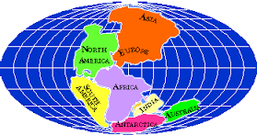
Continental Drift
Idea proposed by Alfred Wegener that states that the continents slowly moved over Earth’s surface.
He believed the continents were once joined together in a supercontinent called Pangaea.
He thought the continents seemed to fit together as a puzzle.

Slide 3
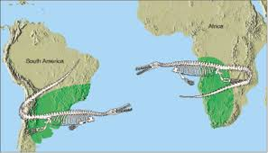
Evidence for Continental Drift
Fossils:
Wegener studied fossils and saw their occurrences on landmasses separated by oceans.
One example, Mesosaurus, is a small lizard that can be found in South America and South Africa, but is not strong enough to swim across the ocean.

Slide 4
Evidence for Continental Drift
Climate:
Wegener studied the fossil and rock records in different climate regions (tropical, polar, etc.)
He found that some fossils of tropical organisms could be found in areas covered by snow, and that arctic organisms’ fossils were found in tropical areas.
As continents move closer to or farther from the equator, their climate changed.

Slide 5
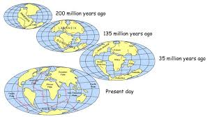
Evidence for Continental Drift
Climate:

Slide 6
Chapter 3: Plate Tectonics
3.2 Sea-Floor Spreading

Slide 7
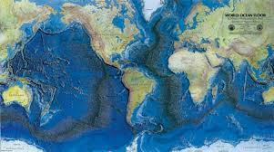
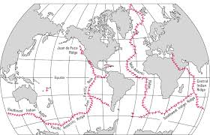
Mid-Ocean Ridges
Mid-ocean ridges form chains of mountains that rise up from the ocean floor.
These are the longest mountain ranges.
They are able to be detected using sonar – a device that uses sound waves to measure distances.

Slide 8
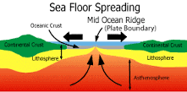
Sea-Floor Spreading
Sea-floor spreading begins at a mid-ocean ridge (crack in the ocean floor).
New molten material rises through this crack, cools, and adds solid rock to the ocean floor.
When the material rises, it pushes existing oceanic floor further away on either side.

Slide 9
Sea-Floor Spreading

Slide 10
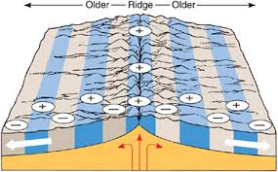
Evidence for Sea-Floor Spreading
Ocean Material: Rocks under water cool quickly, forming shapes like pillows.
Magnetic Stripes: magnetic reversals can be found in the rocks on the ocean floor; the same patterns are found on either side of a mid-ocean ridge.

Slide 11
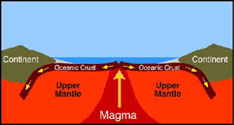
Evidence for Sea-Floor Spreading
Drilling Samples: scientists drilled at different locations and found that the farther away they were from a mid-ocean ridge, the older the rock was.

Slide 12
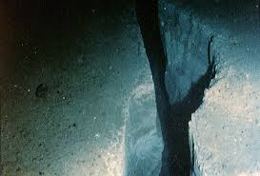
Deep Ocean Trenches
Deep-ocean trenches are deep underwater canyons; an area in which the oceanic crust bends downward.

Slide 13
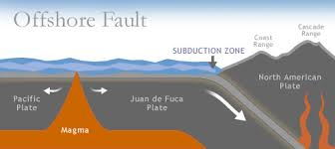
Subduction
Subduction: the process by which the ocean floor sinks beneath a deep-ocean trench and back into the mantle.
As crust cools, it becomes cooler and more dense. Gravity pulls this dense material down into the mantle.

Slide 14
The Ocean Floor
Subduction and sea-floor spreading work together to change the shape and size of the oceans.
The ocean floor renews ever 200 million years.
The more trenches in an ocean, the smaller it is likely to get.
The Atlantic ocean is currently expanding because it only has a few tranches.

Slide 15
Chapter 3: Plate Tectonics
3.3 The Theory of Plate Tectonics

Slide 16
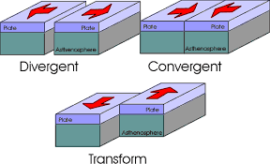
Plate Tectonics
Earth’s crust is separated into pieces called plates.
The plates meet at boundaries.
Divergent: plates move apart from each other.
Convergent: plates come together.
Transform: plates slip past each other.

Slide 17
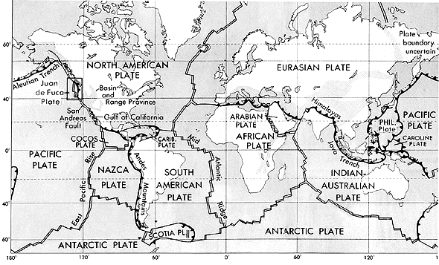
Theory of Plate Tectonics
The theory of plate tectonics states that Earth’s plates are in slow, constant motion, driven by convection currents in the mantle.

Slide 18
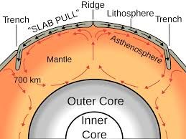
Mantle Convection
When gravity pulls dense crust into the mantle during subduction, the rest of the plate also moves in that same direction.

Slide 19
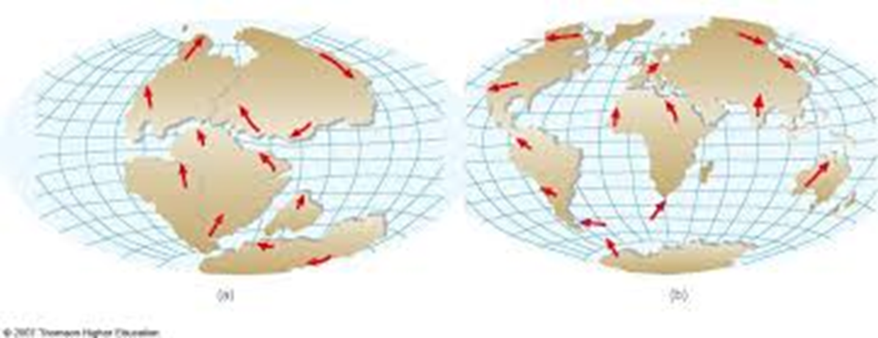
Plate Motions Over Time
Plates move 1-12 cm per year.
The North American and Eurasian plates move apart 2.5 cm every year.

Slide 20
Plate Boundaries
Faults are breaks in Earth’s crust where rocks have slipped past each other.
They form along plate boundaries.

Slide 21
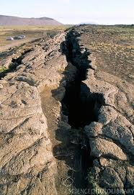
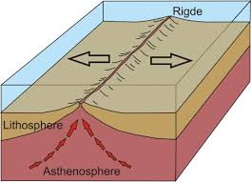
Divergent Boundaries
Plates move away from each other.
Most can be found along mid-ocean ridges.
On land, this can lead to deep valleys called rift valleys.

Slide 22
Convergent Boundaries
Plates move toward each other.
Three types of collisions:
Oceanic-oceanic collision: the denser of the two crusts will go through subduction and sink into the mantle.
Oceanic-continental collision: because oceanic crust is more dense, it can be subducted and cause the continental crust to bend and fold, making mountains and/or volcanoes.
Continental-continental collision: the two landmasses collide, bend, fold, etc. to form mountains.

Slide 23
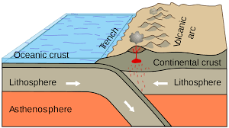
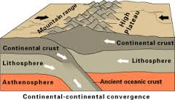
Convergent Boundaries

Slide 24
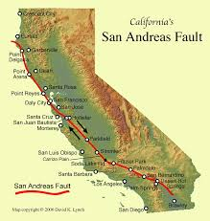
Transform Boundaries
Plates slide past each other.
Earthquakes often occur at this type of boundary due to the jagged edges of the plates.
Crust is neither created nor destroyed here.
San Andreas Fault is an example in CA.

